Slide 1

INTRO TO GIT & GITHUB
Notes:
http://bit.ly/supdecogit
https://bit.ly/githubgeneral

Slide 2
Installation and configuration
Git is installed
PC: https://git-scm.com/downloads
Command line (DOS)
Default editor: VI (but change it to Notepad or other)
git is added to your PATH
Defaut branch is main
MAC: Git is already installed
Terminal (Linux)
git config --global user.email youremail
git config --global user.name yourname

Slide 3
Scenario 1 – In the terminal
mkdir SampleApp - create new folder named SampleApp
cd SampleApp - go to the project folder
git init - initialize the repository
Create a new file: file.txt
Mac: touch file.txt PC: echo test > file.txt
git status - view the repository status
git add . - stage the files to commit and tell get what files to track, "." selects all the new files or files with changes
git commit file.txt -m "New file" - add the changes to the repo with the named file, "-m" indicates message included
git log – see the logs of the changes
git log --oneline - small logs

Slide 4
Scenario 1 – Correct the last commit message
Mac: touch file.html PC: echo test > file.html
Mac: touch otherfile.html PC: echo test> otherfile.html
git add .
git commit –m "file.html and otherfile.html"
git log --oneline
[Do some git status, git add here… These staging things will be added to the previous commit]
git commit --amend -m "commit file.html and otherfile.html"
git log --oneline
Notes:
echo hello > file1.html

Slide 5
Scenario 2a – Recover a deleted file that WAS NOT committed
You deleted a file and immediately realized it was a mistake!
MAC: rm file.html PC: del file.html
MAC: ls –al PC: dir
git status
git checkout file.html
git status
MAC: ls –al PC: dir
Is the file back?

Slide 6
Scenario 2b – Recover a deleted file that WAS committed
You made a commit deleting a file, but then realized you wanted to keep the file around after all!
MAC: rm file.html PC: del file.html
git add .
git commit –m "remove file.html"
MAC: ls –al PC: dir
git log --oneline
git reset --hard HEAD~1
MAC: ls –al PC: dir
git log –-oneline
Is the file back?
Notes:
If you use git reset HEAD~1 you need to then use checkout

Slide 7
Scenario 2c – Recover a deleted file after MORE commits
If you deleted a file, committed, then continued work and did more commits, only to find that deleting the file was a mistake
Find the right commit where the file is still present
git log --follow -p -- filename
git checkout hash filename
Is the file back?
Notes:
If you use git reset HEAD~1 you need to then use checkout
History of a file in the repo
git log --stat -p -- <filename>

Slide 8
Scenario 3 – Reverting a commit
Sometimes you just need to go back to a previous version!
Going back to the version before the last commit
git revert HEAD
Going back to a version with a provided hash
git revert <commit hash>

Slide 9
Scenario 1: Clone a repository
Go to GitHub
Create a repository Remote initialized with a README.md file
Go to the terminal
Make a new directory: mkdir Local
cd Local
Clone the remote repository in Remote using
git clone https://github.com/yourpseudo/Remote.git
cd Remote
On what branch are you?

Slide 10
Scenario 2: Push changes to GitHub
Change the README.md file and add a file (e.g., index.html) locally
Commit your changes
git add .
git commit –m "add index.html and correct README.md"
Showing the remote
git remote
git remote show origin
Push the changes to the remote in GitHub
git push origin main
Check GitHub
TO DO SEVERAL TIMES

Slide 11
git push origin main
Takes the local commits (of the main branch) and upload them to the remote server (origin) on GitHub on the (main) branch

Slide 12
Create a branch
Create a branch
git branch develop
Use the branch
git checkout develop
[or in one line
git checkout –b develop]
Give good names to the branches!

Slide 13
Scenario 3: Create a branch and push work to this branch in GitHub
Create a branch: develop and go to this branch
git branch develop
git checkout develop
Make some local changes in index,html
Commit the changes
Switch to the main branch
git checkout main
Look at the content of index.html
Switch back to the develop branch
git checkout develop
Look at the content of index.html
Push the branch to the remote repository
git push origin develop
What is happening in GitHub?
Pull the changes from remote (made by other developers) before making any commit
git pull [nothing to pull here but do it as an habit]

Slide 14
Other commands on branches
View all the branches and on what branch you are
git branch
View remote tracking and local branches
git branch –a
Rename a branch
git branch –m oldbranchname newbranchname
Delete a branch
git branch –d branchname
You cannot be on the branch you want to delete!

Slide 15
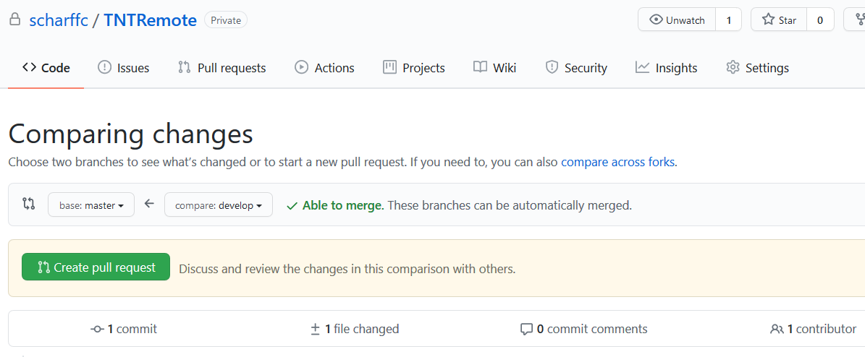
Scenario 5: Create one more pull request
Pull the files on master
git checkout main
git pull
On the develop branch, work on the files locally, make changes and commit them
Push the changes
git push origin develop
Go to GitHub, create a pull request
using the interface and merge it

Slide 16
Scenario 7: Delete index.html in GitHub
We will delete a remote file that is local too!
In the terminal do the following:
On the develop branch in the terminal
git rm index.html
git add .
git commit –m "delete index.html"
git push origin develop
Do the pull request in GitHub
Go back to the terminal
git checkout main
git pull

Slide 17
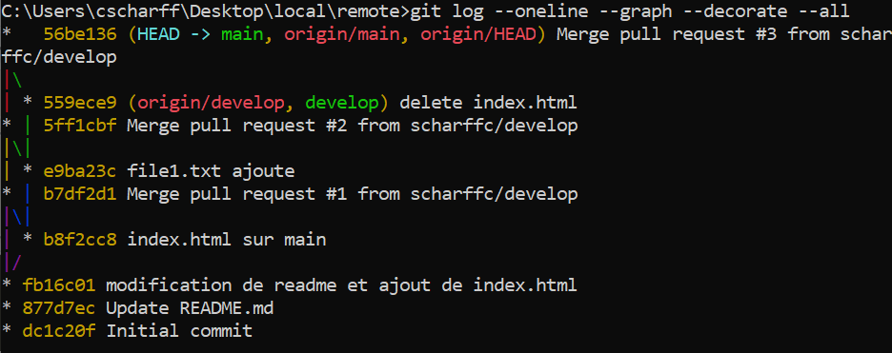
Other commands to use
git diff HEAD
git diff --staged
git log --oneline
git log --oneline --graph --decorate --all

